Slide 1


232 JAVA SL - GROUP 4
HOUSEKEEPER SCHEDULING SYSTEM
We love to clean and it shows!

Slide 2
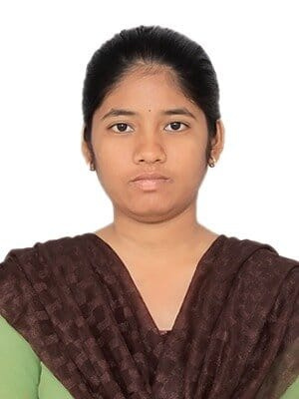
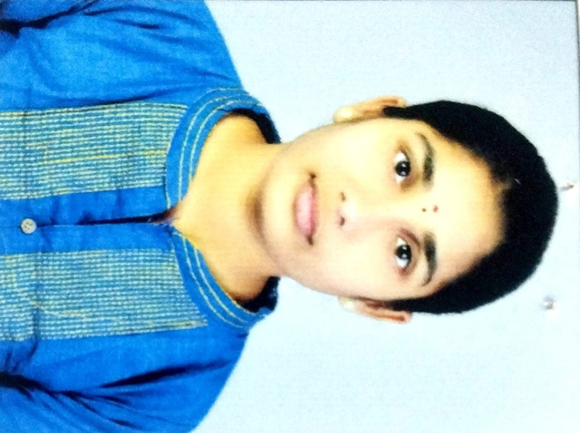
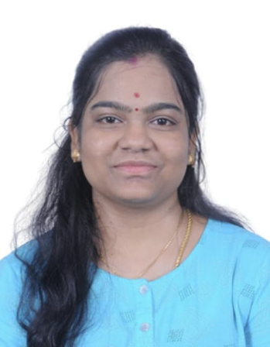

1
Meet our Team
Madem lakshmi Priyanka
2576805
World’s Best Team for Java Development!
2
Malladi Chathurya
2576505
3
MP Sriviji
2577316
4
Mukilan Chakkarapani (TL)
2575714

Slide 3
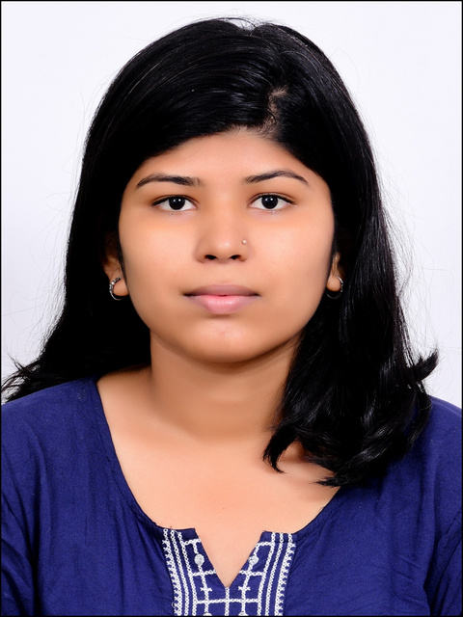
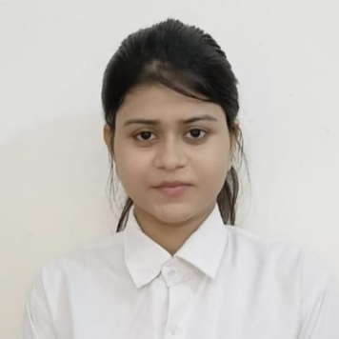

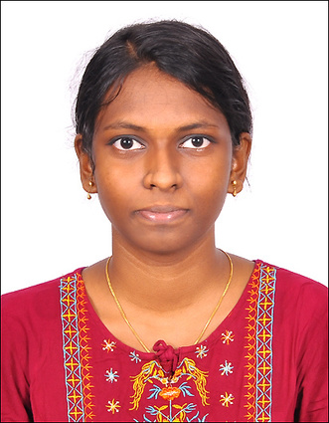
5
Meet our Team
Nagajyothi R S
2575956
World’s Best Team for Java Development!
6
Nancy Singh
2576032
7
Naveen Karthik B
2577316
8
Nisha R
2575956

Slide 4

Content
Abstract
Purpose
Modules
Technologies used
Project Architecture & Design
Snippets
Advantage
Conclusion

Slide 5

ABSTRACT
The project focuses on resolving scheduling issues in hostel room cleaning services. We created a web application that empowers students to seamlessly request and schedule cleaning services, considering their diverse class schedules. This initiative aims to optimize the hostel management system by providing an efficient and user-friendly platform for managing cleaning requests and schedules.

Slide 6
Purpose
As a Team, the objective is to create a feature-rich online housekeeping scheduling system that aligns with the provided requirements and business model, offering a seamless and intuitive experience for hostel students to request and receive timely room cleaning services.

Slide 7
MODULES
Admin Module (Login, Register) - Naveen Karthik B
To Create admin account and to login to admin dashboard.
User Module (Login, Register) - Nisha R
To Create User account and to login to user dahsboard.
Dashboard/Navbar Module & Request (Admin) - MP Sriviji
To access other modules and to navigate between modules.
Register New Housekeeper and Student - Mukilan Chakkarapani
To register new housekeeper and new student in admin side.

Slide 8
MODULES
Feedback Module (User) - Nagajyothi
To get feedback from the user side.
Request Module (Admin) & Welcome page - Malladi Chathurya
To allot housekeeper to the appropriate requests.
Feedback Module (Admin)
To access other modules and to navigate between modules.
Update Module (Profile & Password) - Madem Lakshmi Priyanka
To update the existing details with newer one.

Slide 9





TECHNOLOGIES USED
FRONTEND
SERVER - SIDE
BACKEND
TESTING

Slide 10
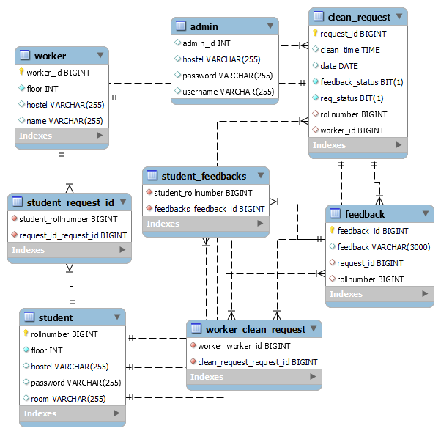
ER DIAGRAM

Slide 11
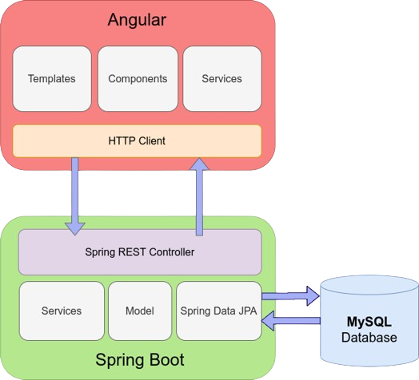
PROJECT ARCHITECTURE
Back to Agenda Page

Slide 12
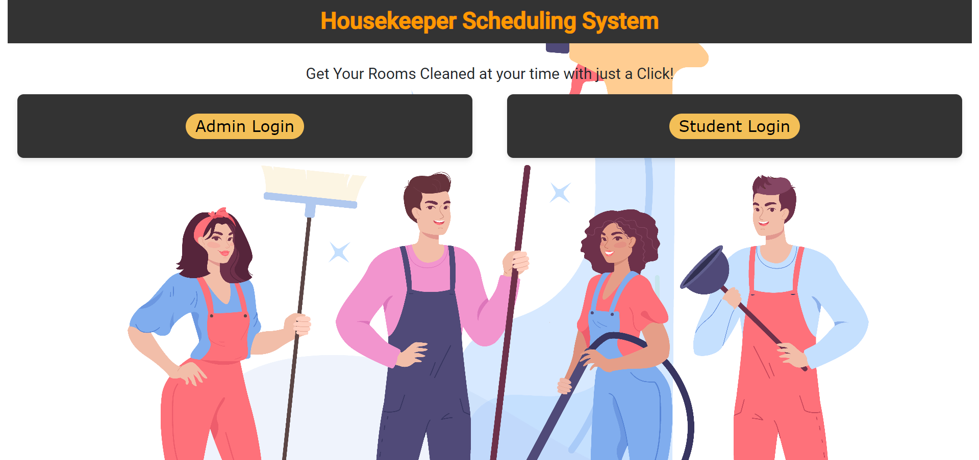
MAIN LOGIN

Slide 13
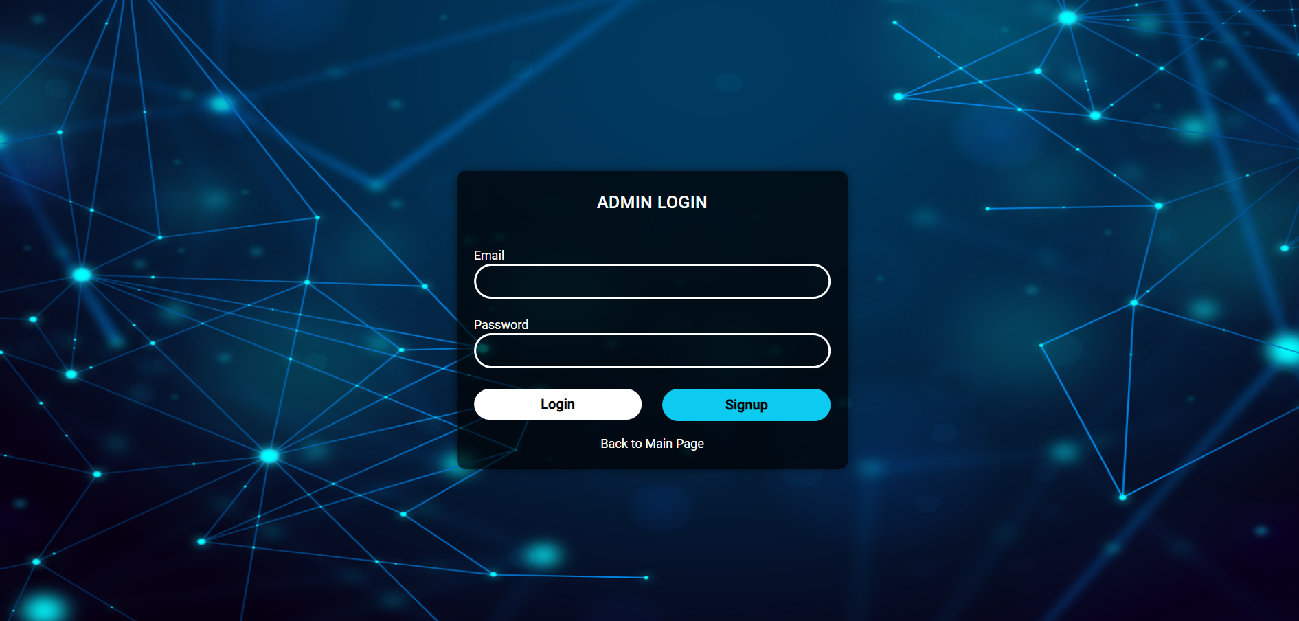
ADMIN LOGIN

Slide 14
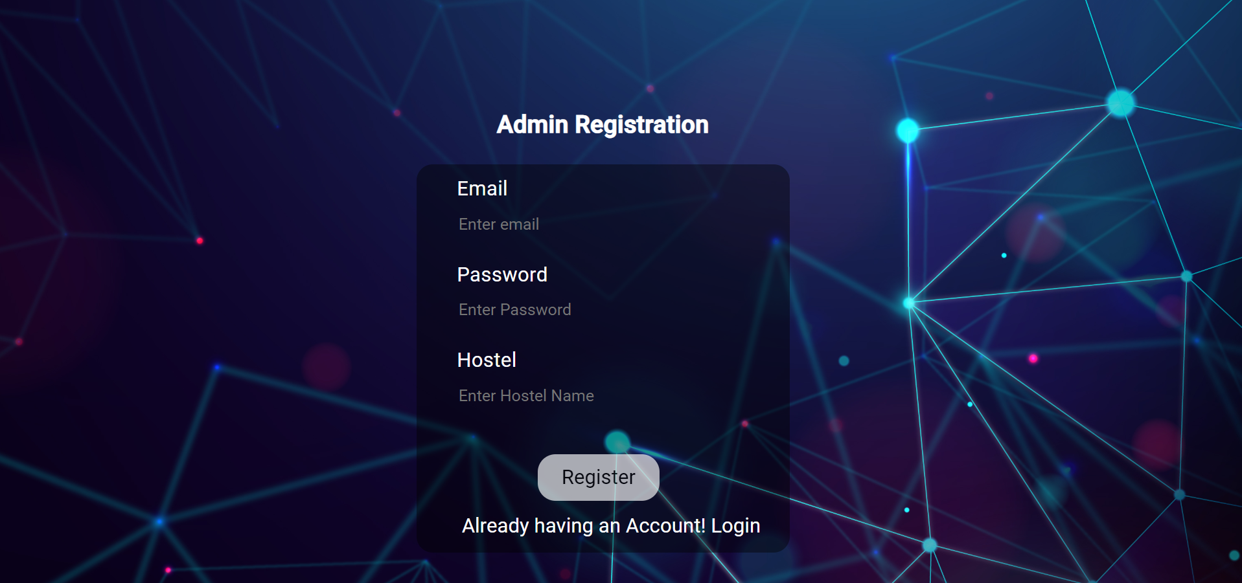
ADMIN REGISTRATION

Slide 15
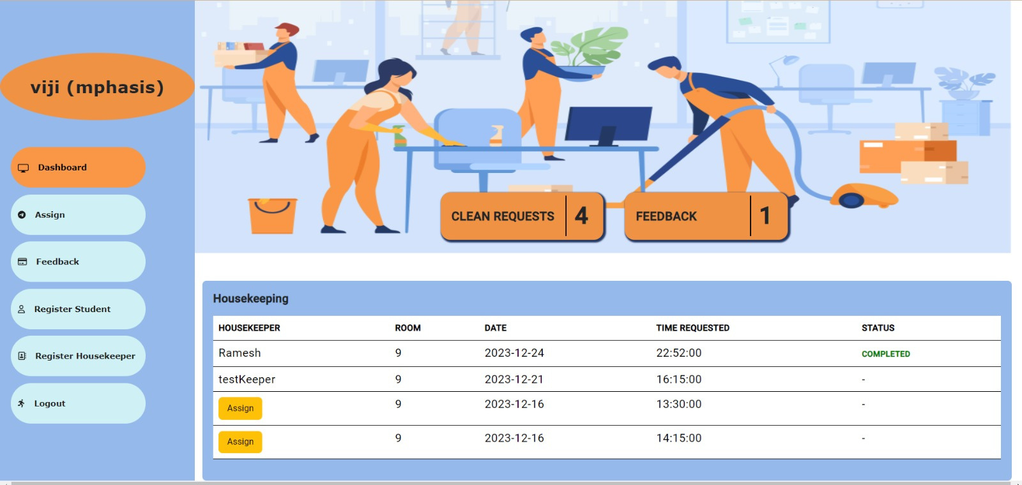
ADMIN DASHBOARD

Slide 16
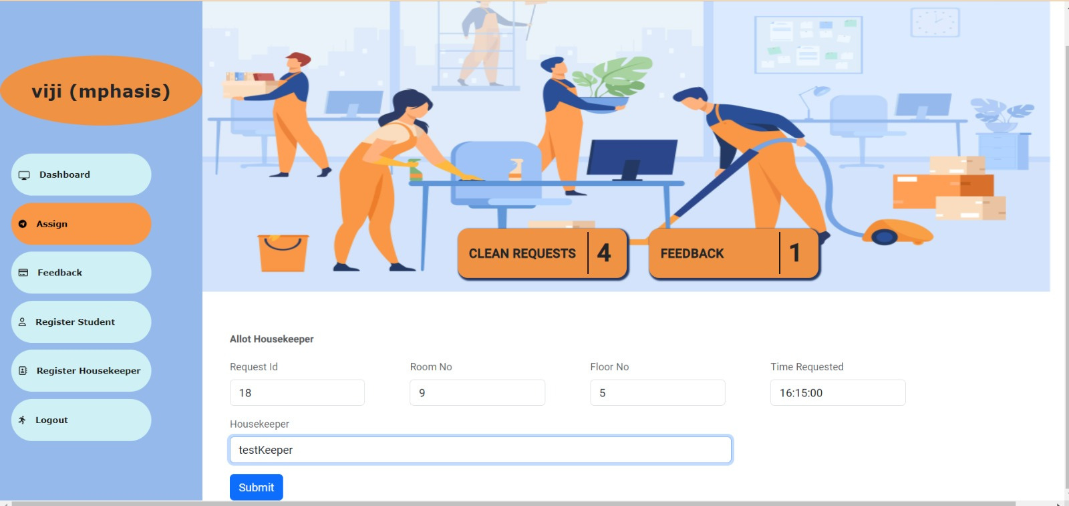
ASSIGN HOUSEKEEPER

Slide 17
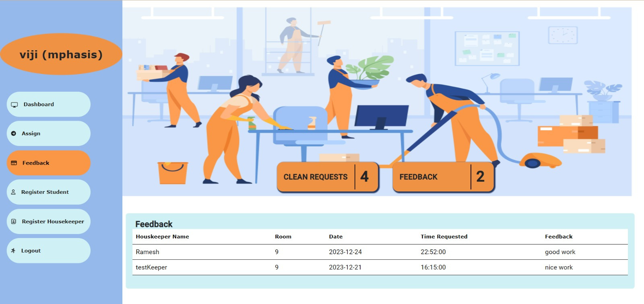
ADMIN FEEDBACK

Slide 18
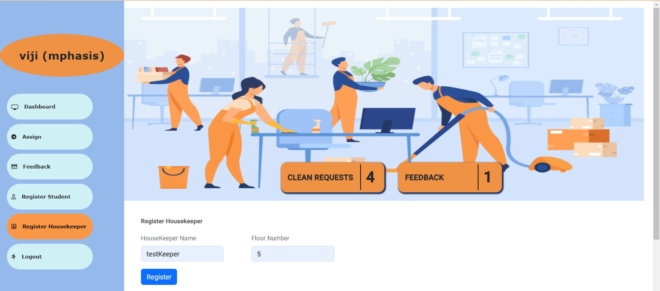
REGISTER HOUSEKEEPER

Slide 19

STUDENT LOGIN

Slide 20
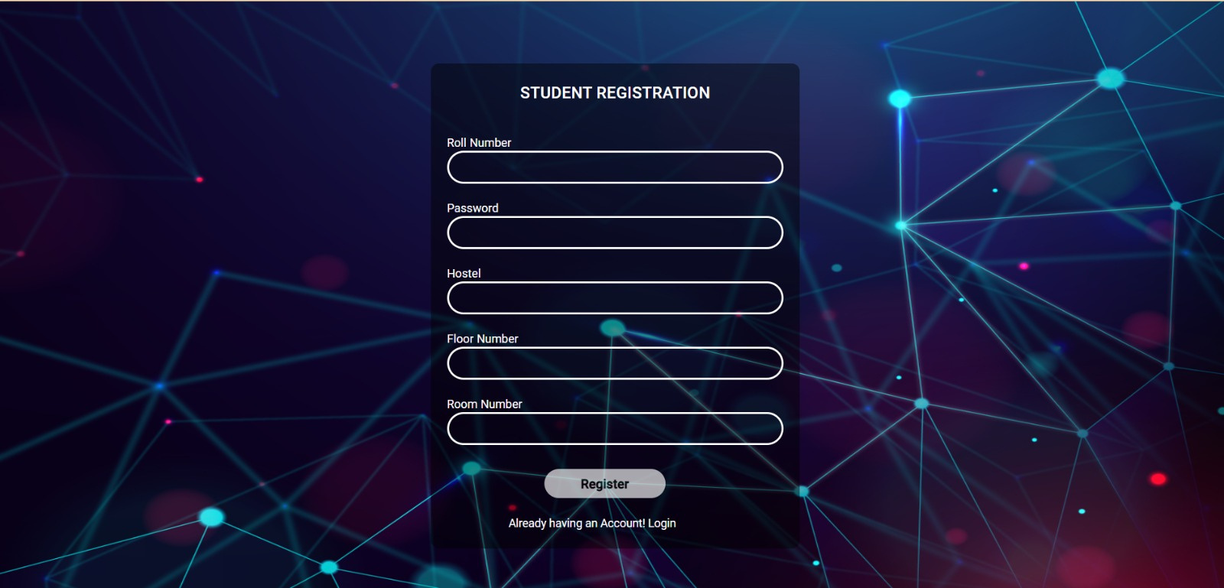
STUDENT REGISTRATION

Slide 21
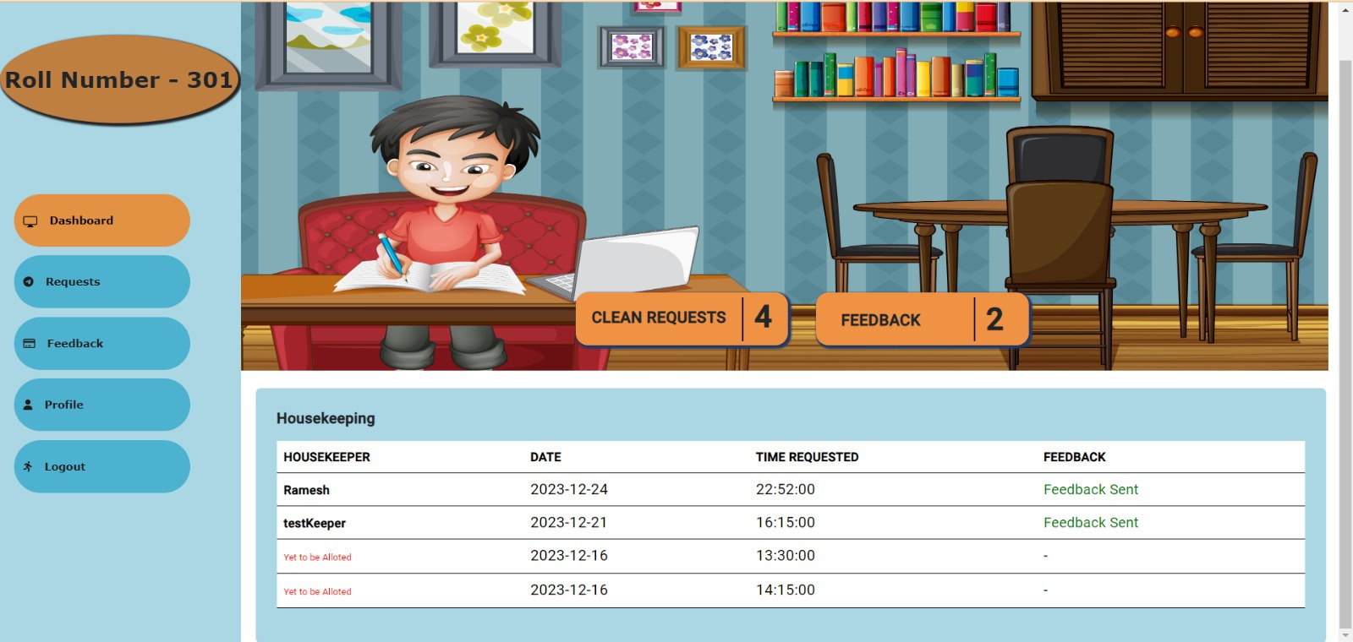
STUDENT DASHBOARD

Slide 22
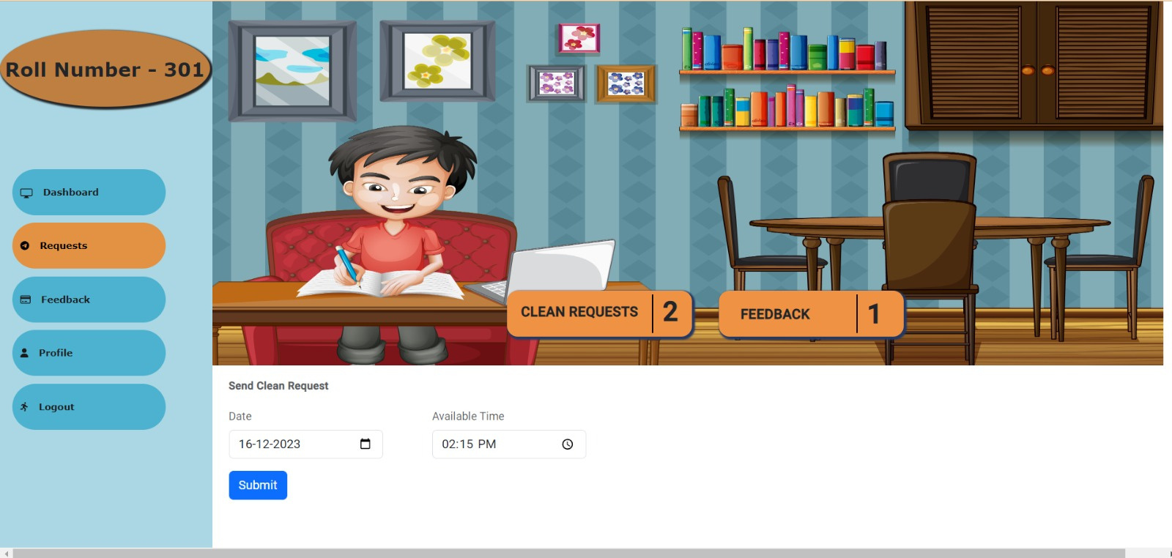
RAISE REQUEST

Slide 23
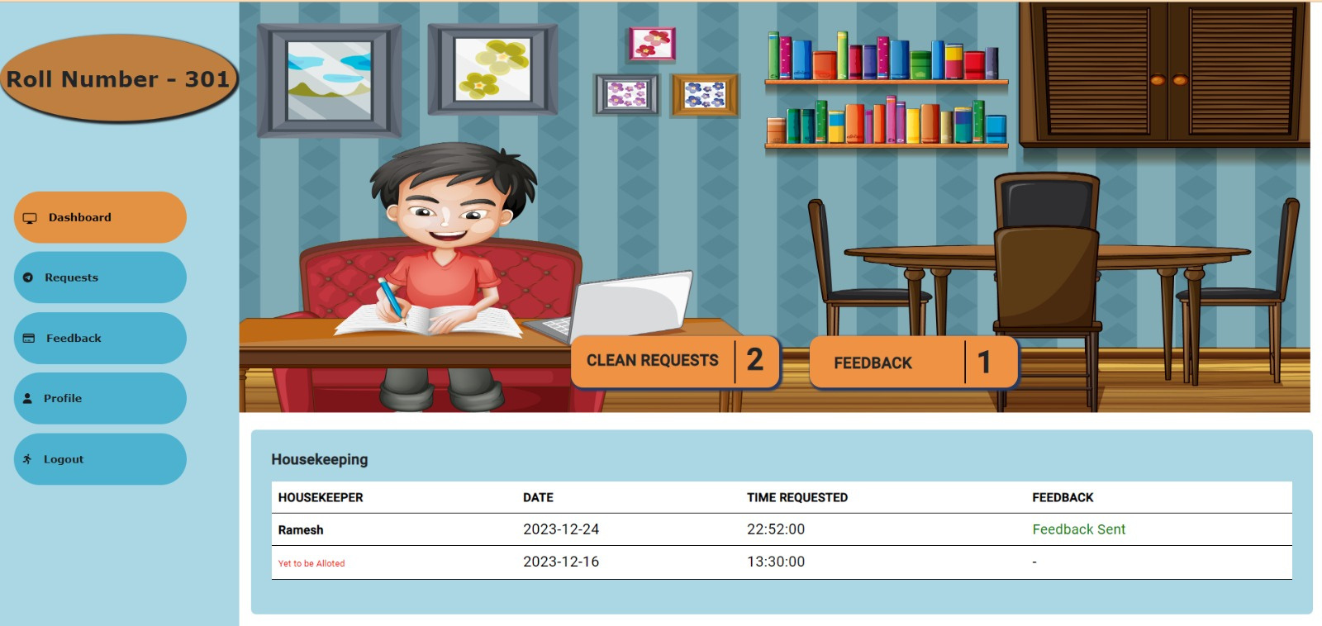
AFTER REQUEST IS MADE

Slide 24
ASSIGNMENT PAGE

Slide 25
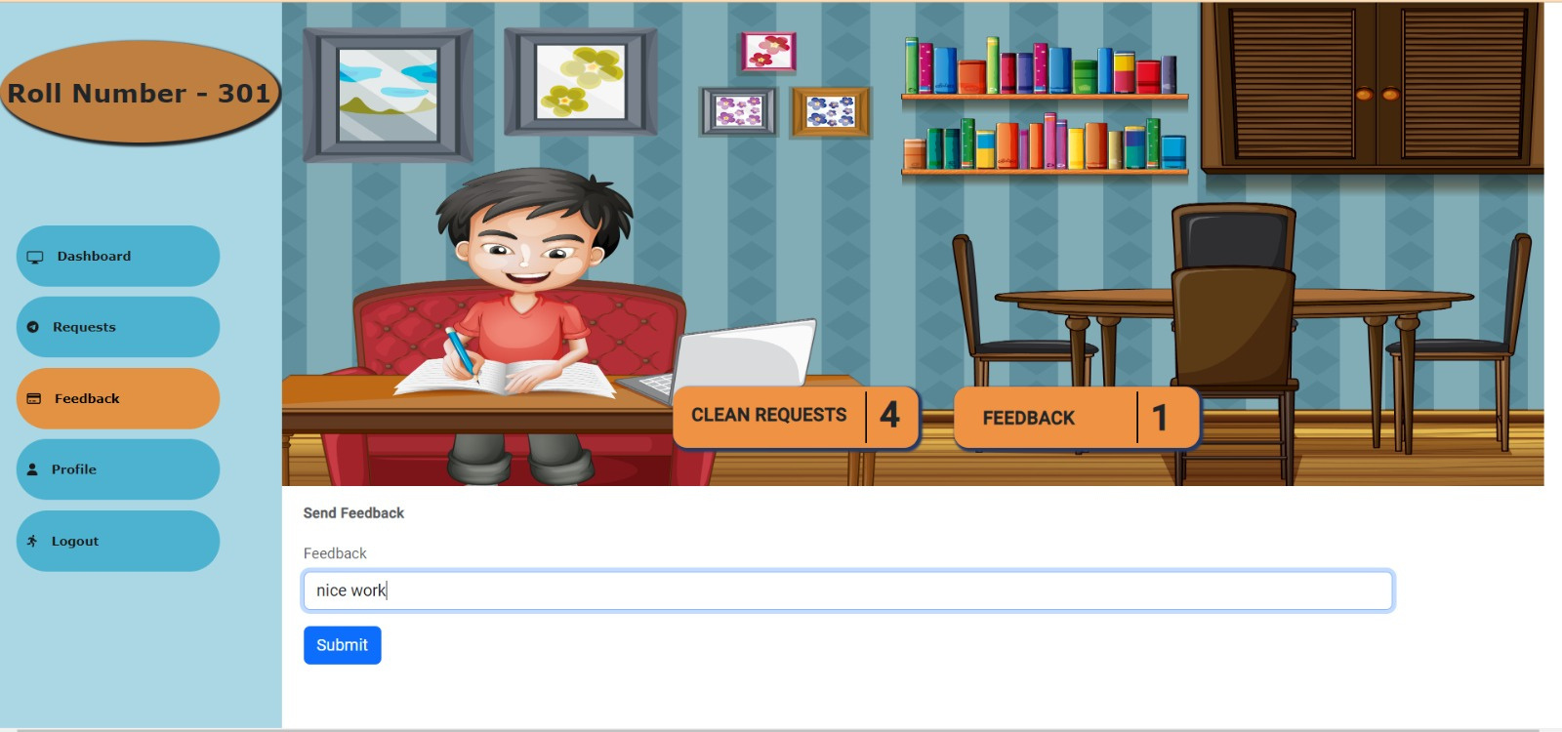
USER FEEDBACK

Slide 26
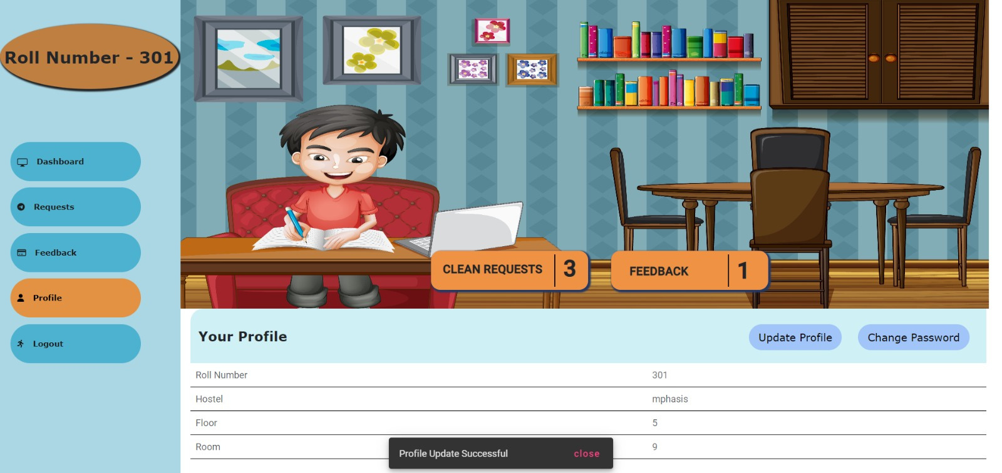
PROFILE PAGE

Slide 27
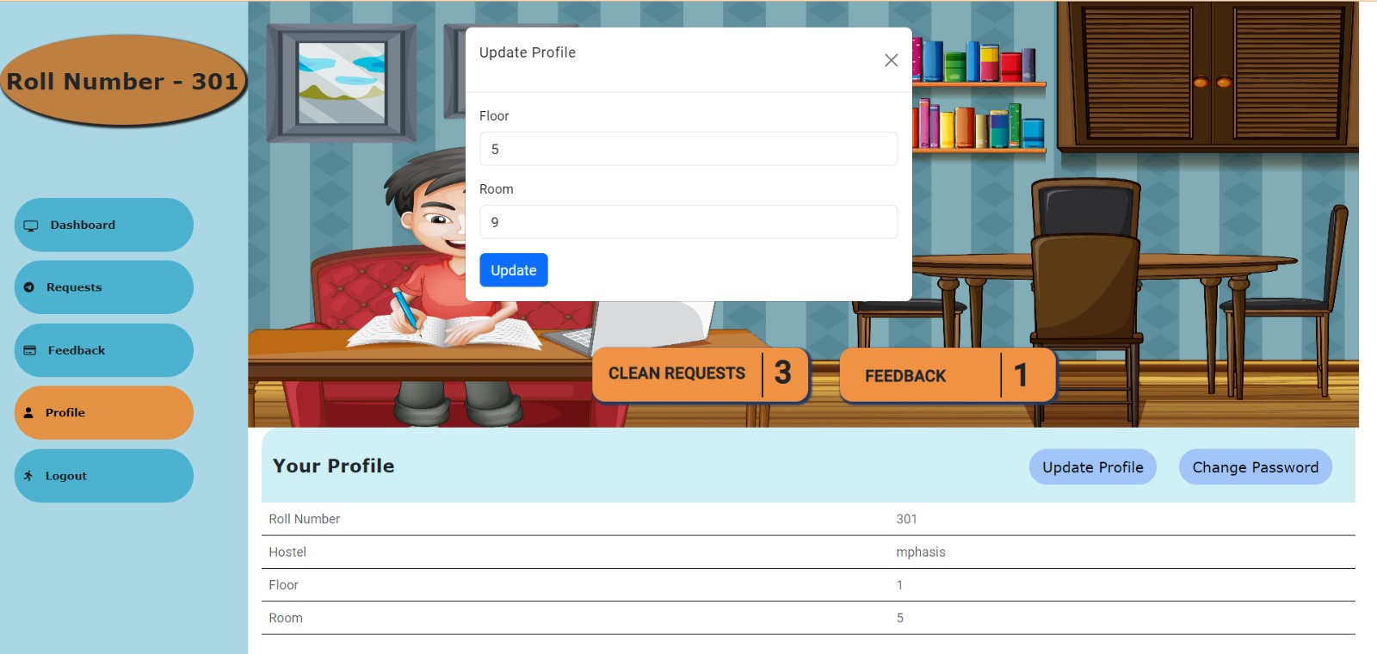
UPDATE PROFILE
Back to Agenda Page

Slide 28
PROFILE AFTER UPDATION

Slide 29
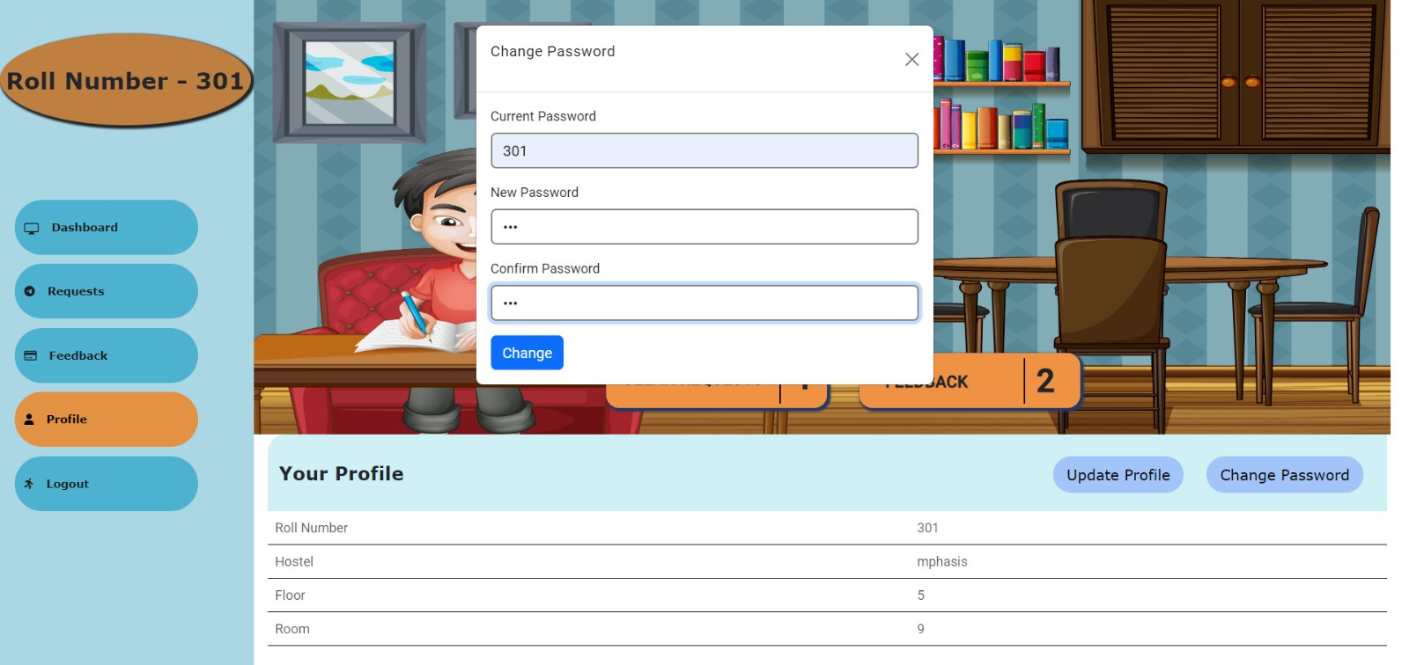
CHANGE PASSWORD

Slide 30
Efficiency: Streamlines taks planning for timely completion.
TimeMangament: Helps housekeepers prioritize tasks and avoid overbooking
Advantages
Resource Optimization: Allocates the right personnel based workload.
Customer Satisfaction: Ensures reliable, prompt services for increased satisfaction.
Reduced Errors: Minimizes scheduling mistakes through active tracking.

Slide 31
This tool is easy to use and simplifies tasks for both administrators and students living in hostels.
Conclusion
This tool is easy to use and simplifies tasks for both administrators and students living in hostels.
Our design prioritizes simplicity and is specifically suited to meet the demands of the hostel administration and students.

Slide 32
THANK YOU!
Thank You - நன்றி (Naṉṟi) - Tamil
Thank You - ధన్యవాదాలు (Dhan'yavādālu) - Telugu
Thank You - धन्यवाद (dhanyavaad) - Hindi
Thank You - നന്ദി (nandi) - Malayalam
Thank You - ಧನ್ಯವಾದ (Dhan'yavāda) - Kannada

